Slide 1
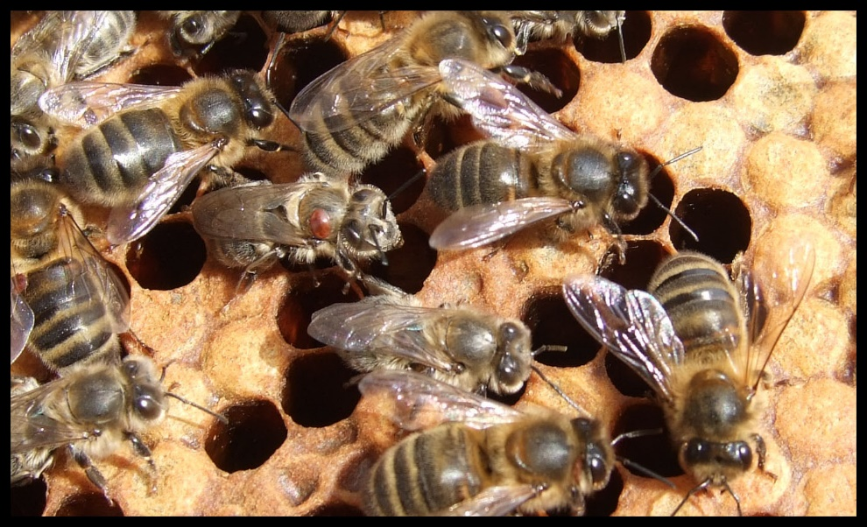
Honey bees in Ireland
Think before you buy
Prof Grace McCormack,
University of Galway and Tribes Beekeeping Club

Slide 2
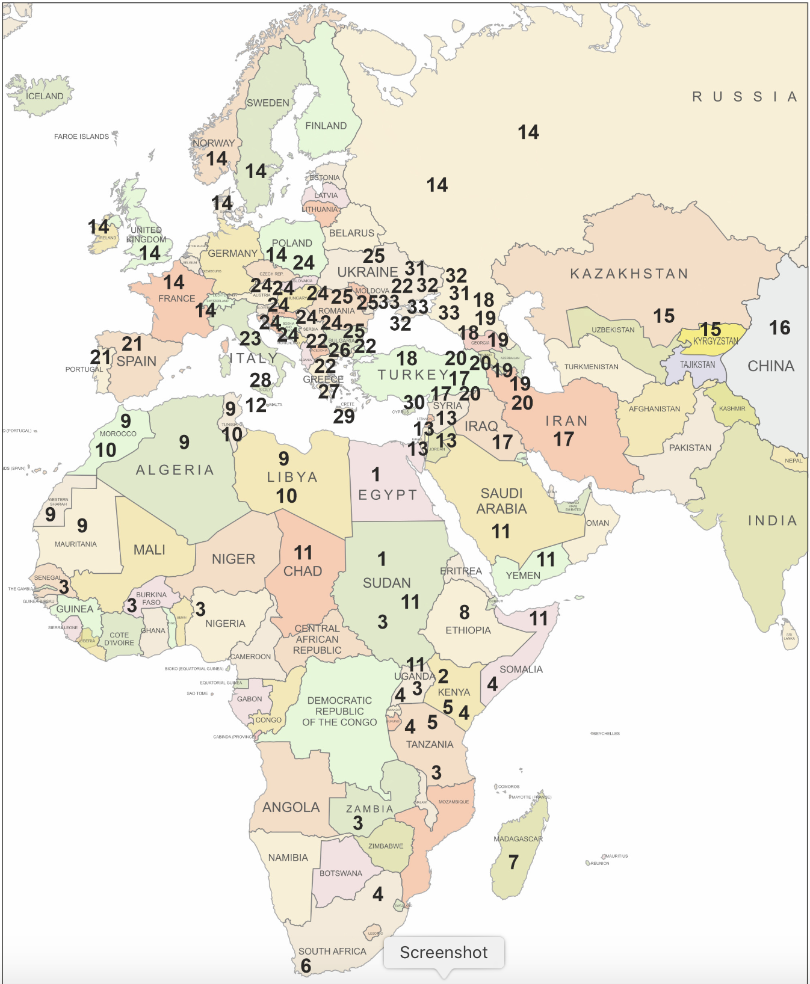
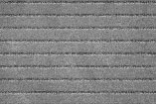
33 subspecies in 5 major lineages
(Ilyasov et al 2020)
Apis mellifera is a very variable species
14 is A. m. mellifera: the native Irish honey bee
Subspecies can be distinguished via behaviour, morphology and DNA
Notes:
There is not just one type of honey bee. Honey bees are not the all the same. Due to adapting to different environments across Africa, Asia and Europe honey bees have evolved into distinct subspecies and local eco-types. Some of these subspecies have been separated for hundreds of thousands of years and had evolved distinct behaviours, morphology and, underlying all of that, distinct genetic composition. After the last ice age, honey bees began to re-colonise Europe and the honey bees that made it to Britain and Ireland is the black bee/ brown bee: Apis mellifera mellifera

Slide 3
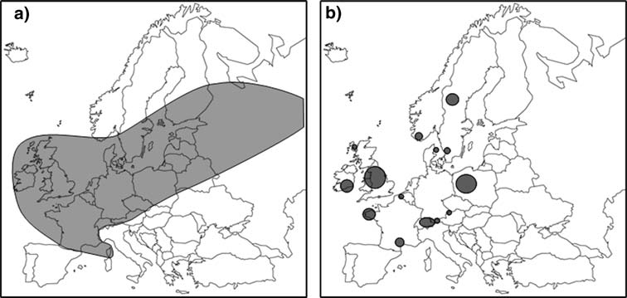
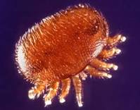
2013: Assumed to be extinct or almost extinct throughout its range - Including Ireland, Wild bees extinct
Irelands conservation story began in the 1990s with the Galtee Bee breeding Group
Notes:
Apis mellifera mellifera (often called Amm in Ireland) used to be very widespread and colonized many different environments from West of Ireland to Russia and from South France to the tree line in Scandinavia. After the first world war Brother Adam thought that this bee went extinct in Britain and Ireland after the so-called Isle of Wight disease. There were many misunderstandings about what happened to cause the drop in population at that time but Br Adam created the Buckfast bee to cope with perceived disease. This Buckfast bee became valued by beekeepers both due to the religious association but also because the bee behaved well during beekeeping. Other strains also seemed better behaved than Amm, e.g. the Italian bee and the carnolian bee. They underwent a lot of selection for traits of interest to beekeepers over many years, and became heavily traded globally. As a result, these non-native subspecies and artificial strains began to replace the dark bee over a lot of its range and the dark bee has since vanished from a lot of its old range, only remaining in pockets of protected populations, except for Ireland where we have a large population of this subspecies left.

Slide 4
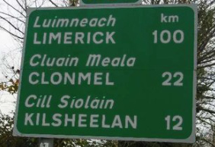
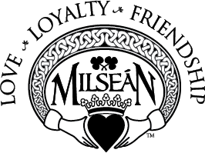
Ireland’s Honeybees
Origins:
  Native
  colonised naturally - circa 8000 years
  Brought over from UK ->1500 years
  Non-Native
  Imported from various places – 100 years
Brehon law academy
https://irisharchaeology.tumblr.com/
Cluain Meala, “vale of honey”
https://www.milsean.com/products/blarney-stones
Notes:
The dark bee is part of Irelands culture and heritage as it has been here for thousands of years before imports started and has become adapted to the environment and climate. It has woven its way into our language, our ancient laws, our place names, our art (e.g. book of Kells), and for many families was part of their way of life- having a hive at the bottom of the garden.
Bees were brought over from the UK since the time of St. Patrick and written and verbal accounts report the presence (though sparse) of bees on the island. Once the hive with moveable frames was developed people started breeding bees for easy management in these boxes and trading them. Since the early 1900s bees from other locations were imported- these are not native.

Slide 5
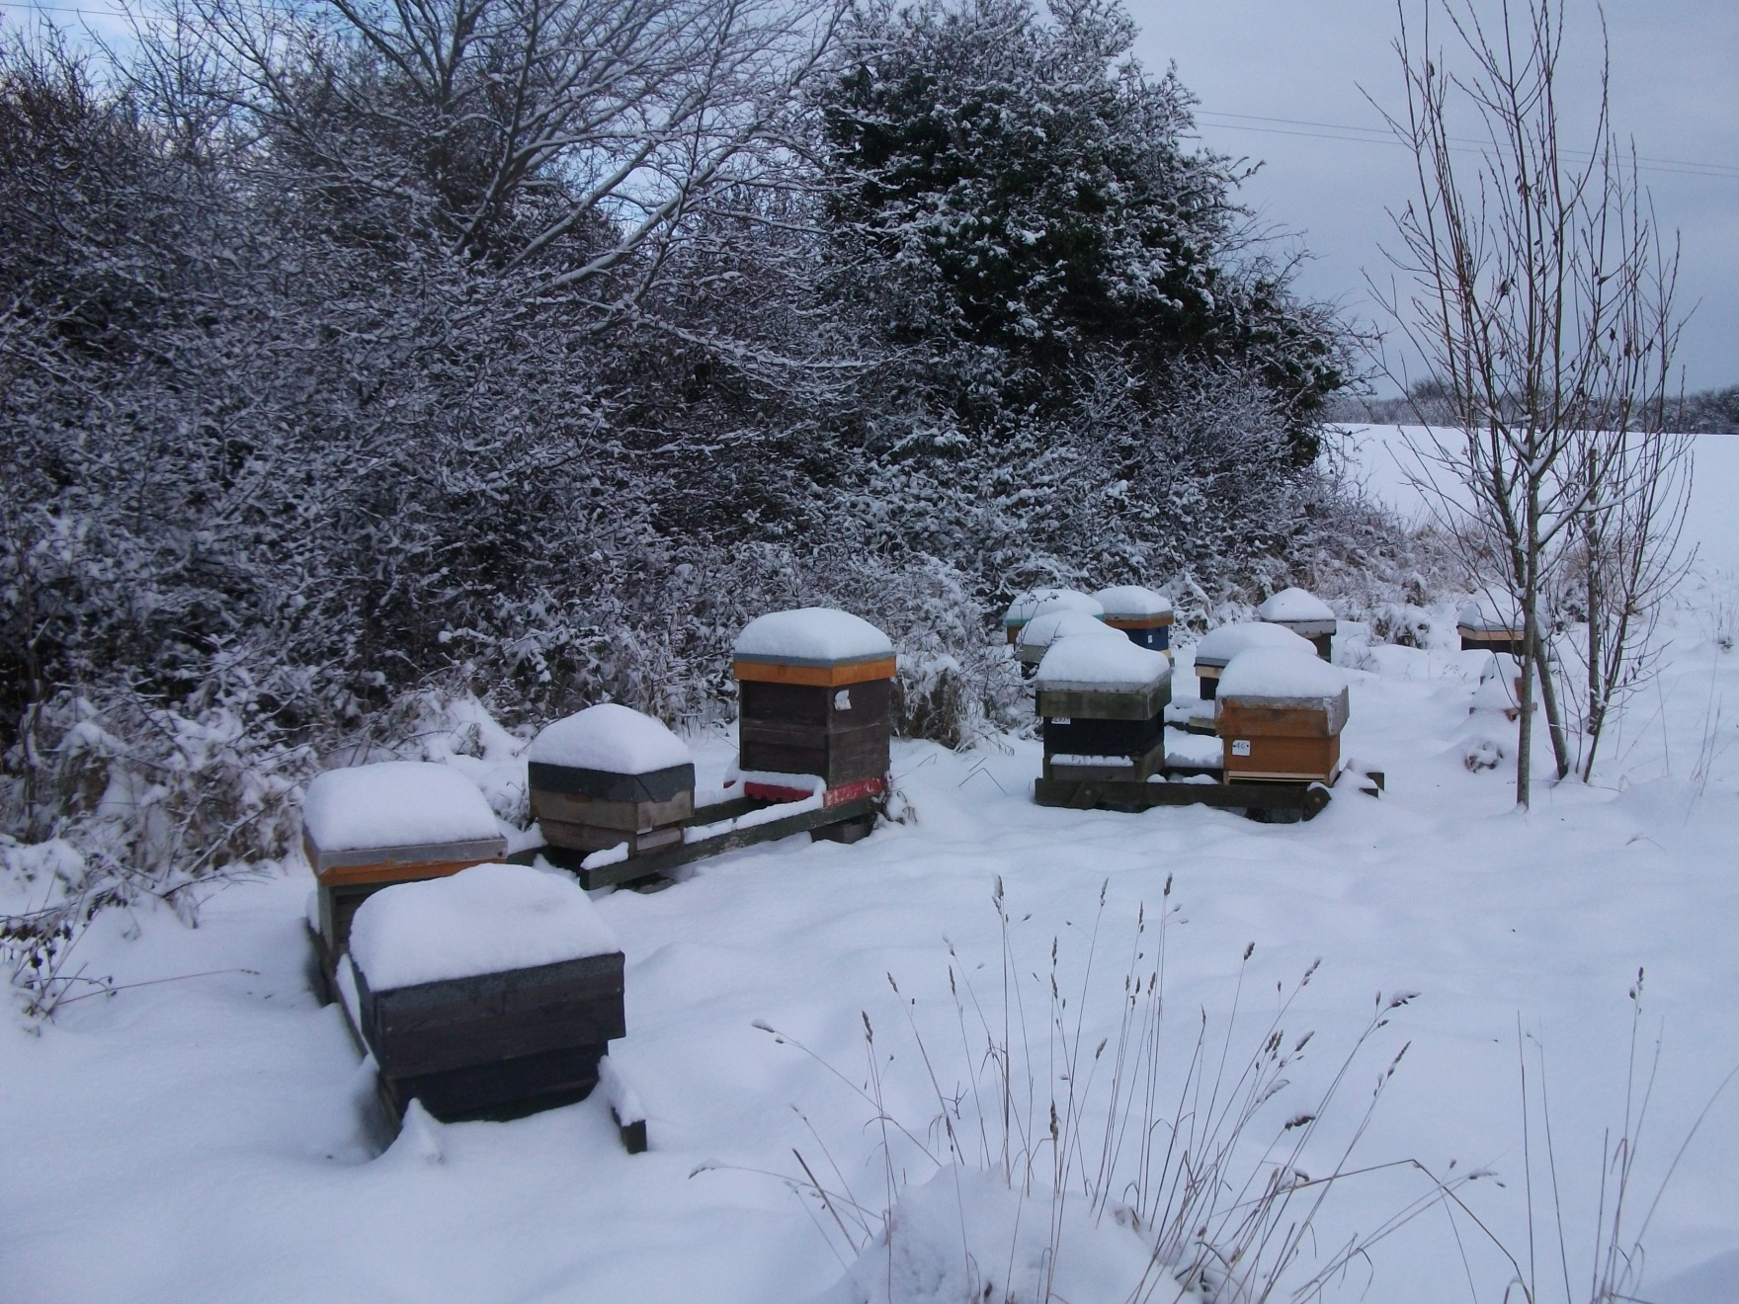
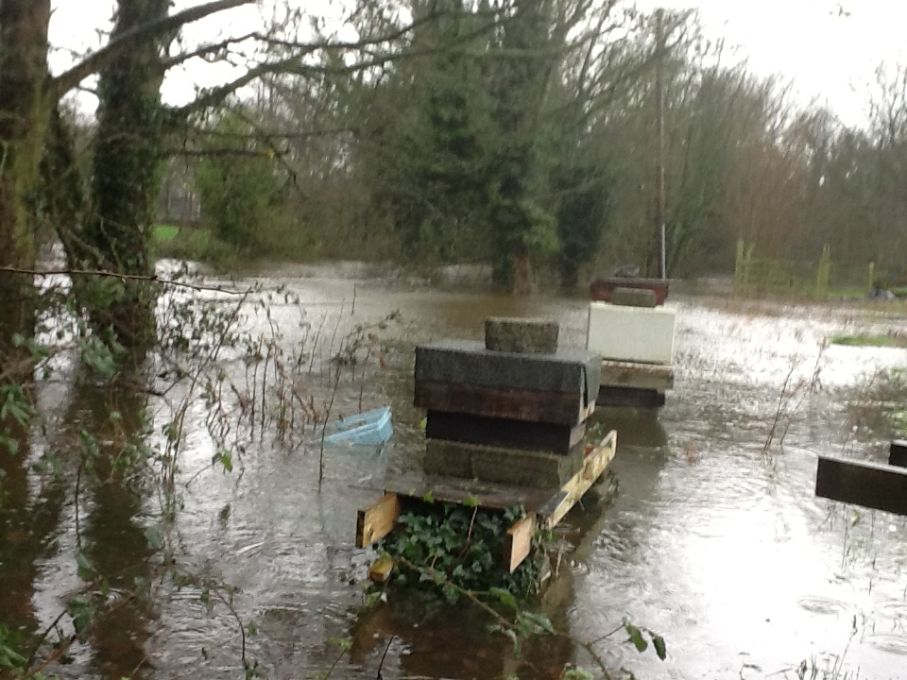
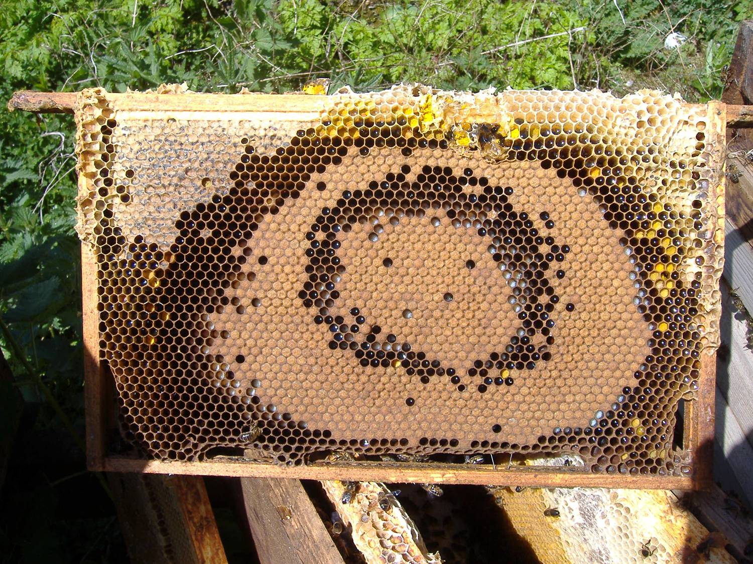
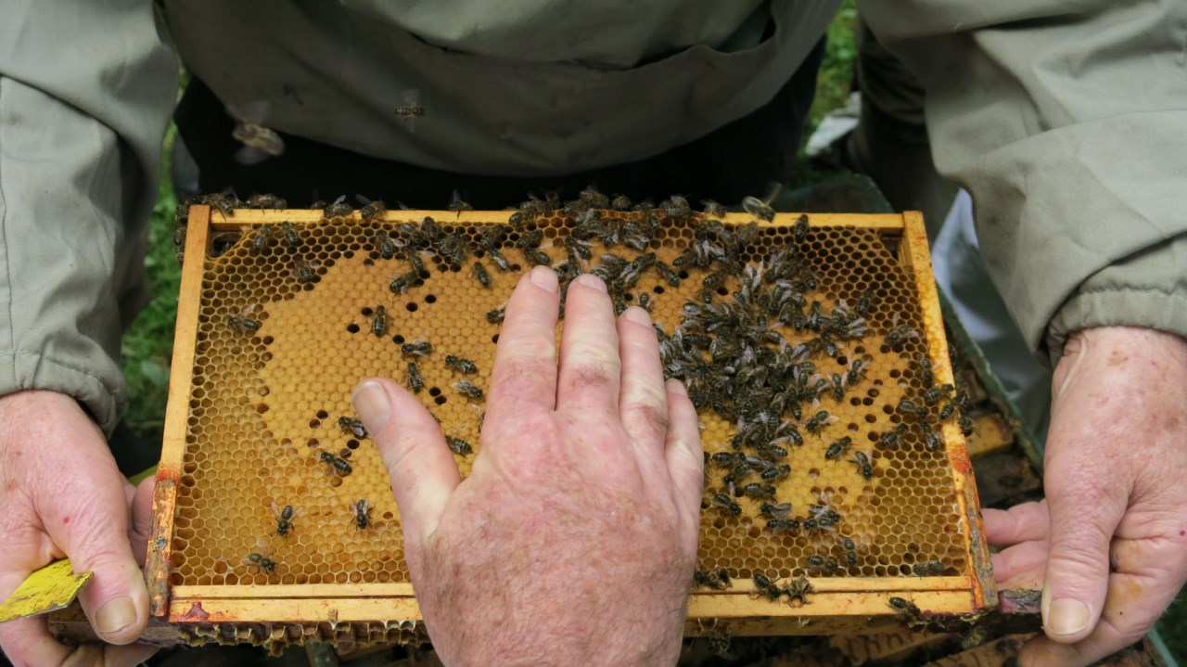
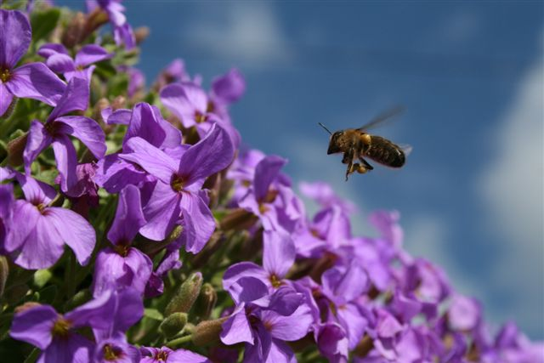
Apis mellifera mellifera is the only honeybee that is native to Ireland
Dark in colour to absorb heat in cool summers
Adaptations to wing and flight muscles to fly in windier/wetter weather
Docile
Colony size small, long lived, good honey, pollen, propolis production
Frugal with stores
Resistance to disease ?
Images & points from Eoin Mac Giollacoda
Notes:
A. m. mellifera has distinctive morphology (physical traits) and behaviours such as on the slide. Also, Irish honey bees take a brood break when forage is low like during the June gap and over winter allowing the bees to not deplete their stores, this also may help with natural control of varroa.

Slide 6
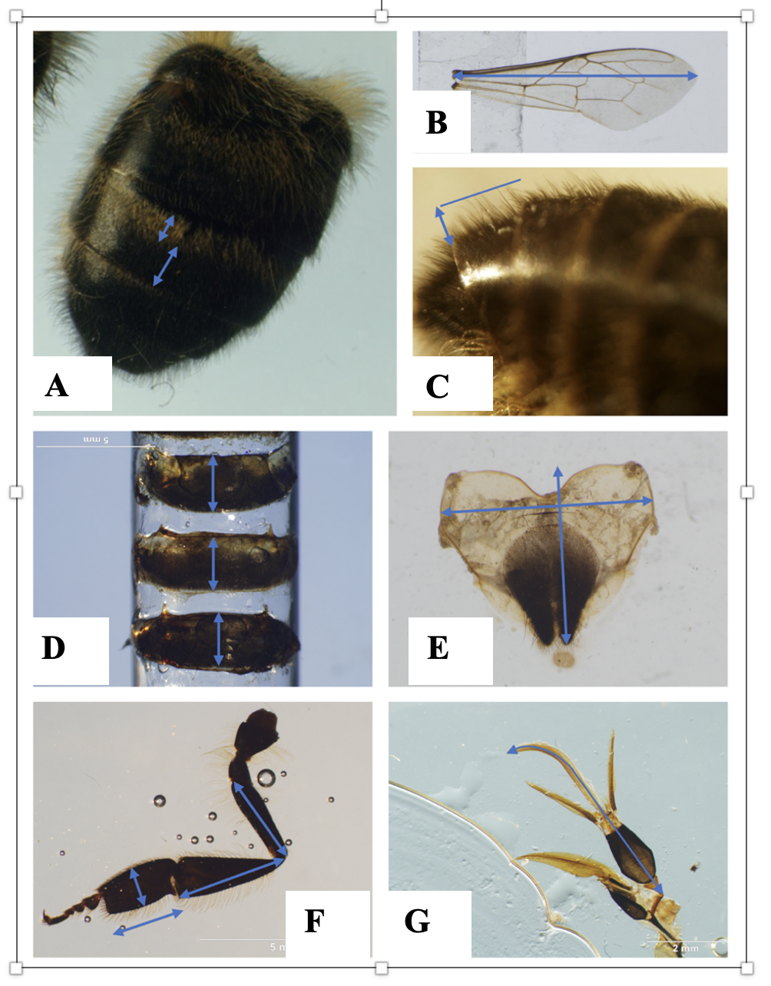
Ireland has unique eco-type
Irish A.m.mellifera is significantly different from European A.m.mellifera & C-lineage subspecies.
Unique variations observed include:
Shortened leg length
Shortened proboscis length
Longer forewings
Broadened but shorter abdomen
Decreased cubital index
Longer overhair length
Valentine et al., 2024; JAR, open access
Notes:
Recent research showed that Irelands population of the dark bee is significantly different even to A. m. mellifera populations elsewhere in Europe- Ireland has a unique eco-type adapted to the climate here. This is confirmed with genetics, in that the Irish bee is distinct genetically from all other populations.

Slide 7
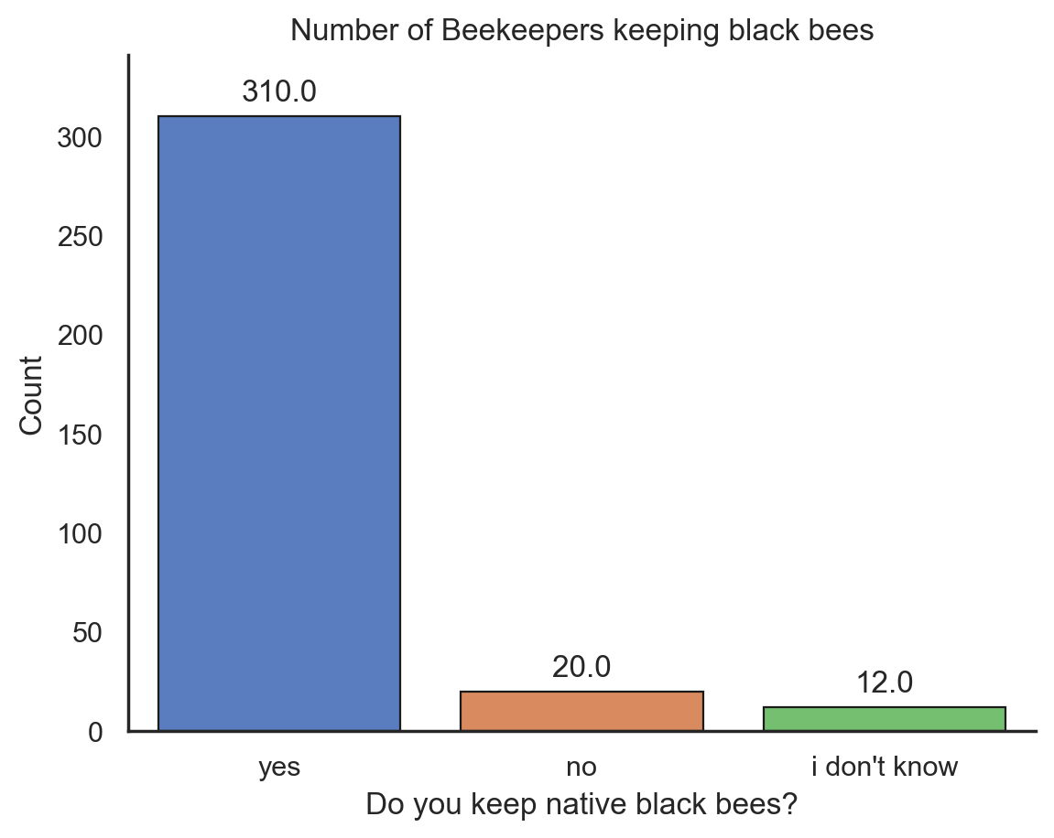
What do Irish Beekeepers think they have?
Survey response by >350 beekeepers 2020
Approx 90% beekeepers keep Apis mellifera mellifera
Smith, Moro, McCormack. (2023). Exploring a Potential Avenue for Beekeeping in Ireland: Safeguarding Locally Adapted Honeybees for Breeding Varroa-Resistant Lines. Insects 2023, 14,827. https://doi.org/10.3390/ insects14100827
Notes:
Most Irish beekeepers keep A. m. mellifera because they think it is the best bee for the environment, because it is the type of bee that is local to them and because a lot of beekeepers are interested in conserving the native honey bee population. Most Irish beekeepers are hobbyist having <10 hives. Very few beekeepers in Ireland have >100 hives.

Slide 8
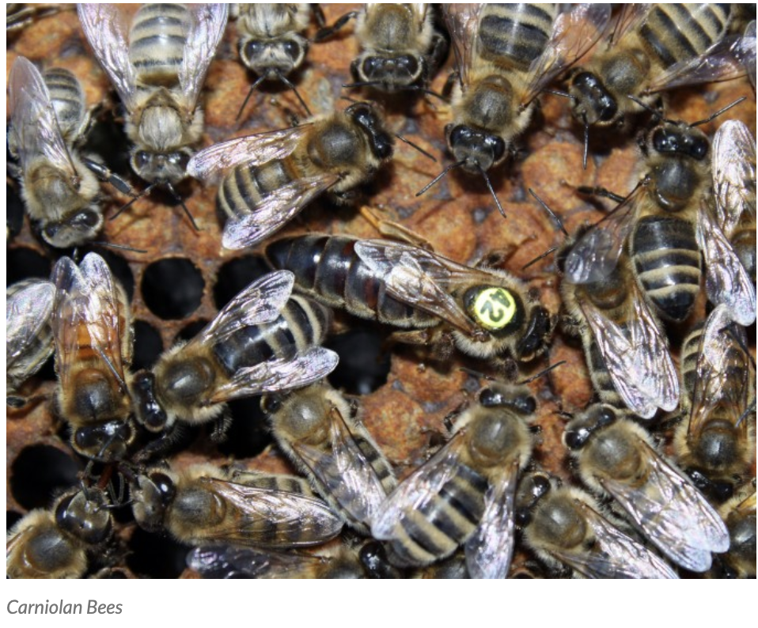
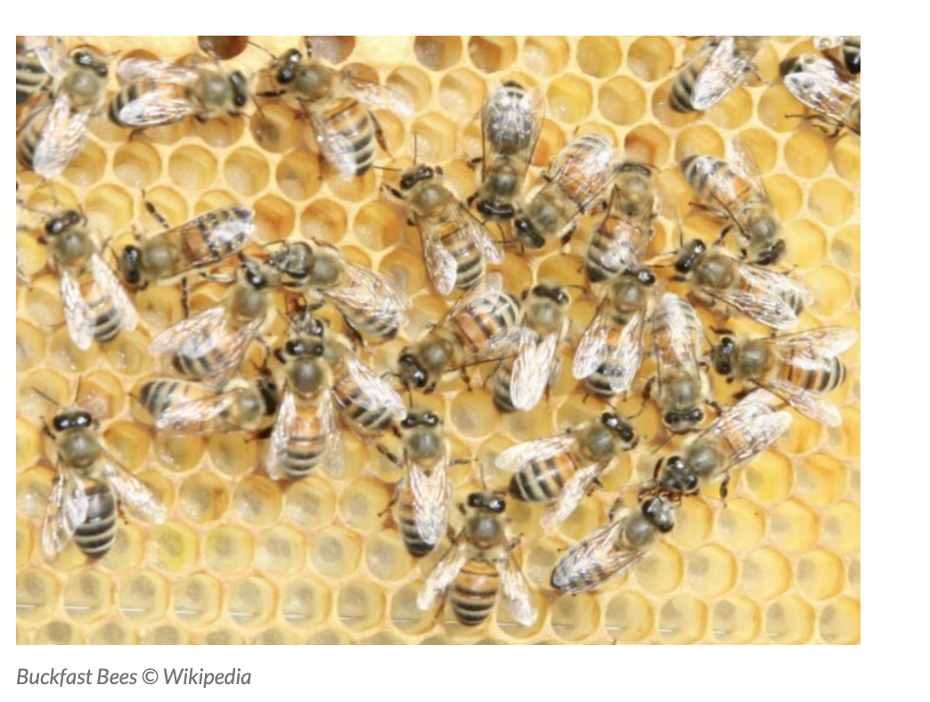
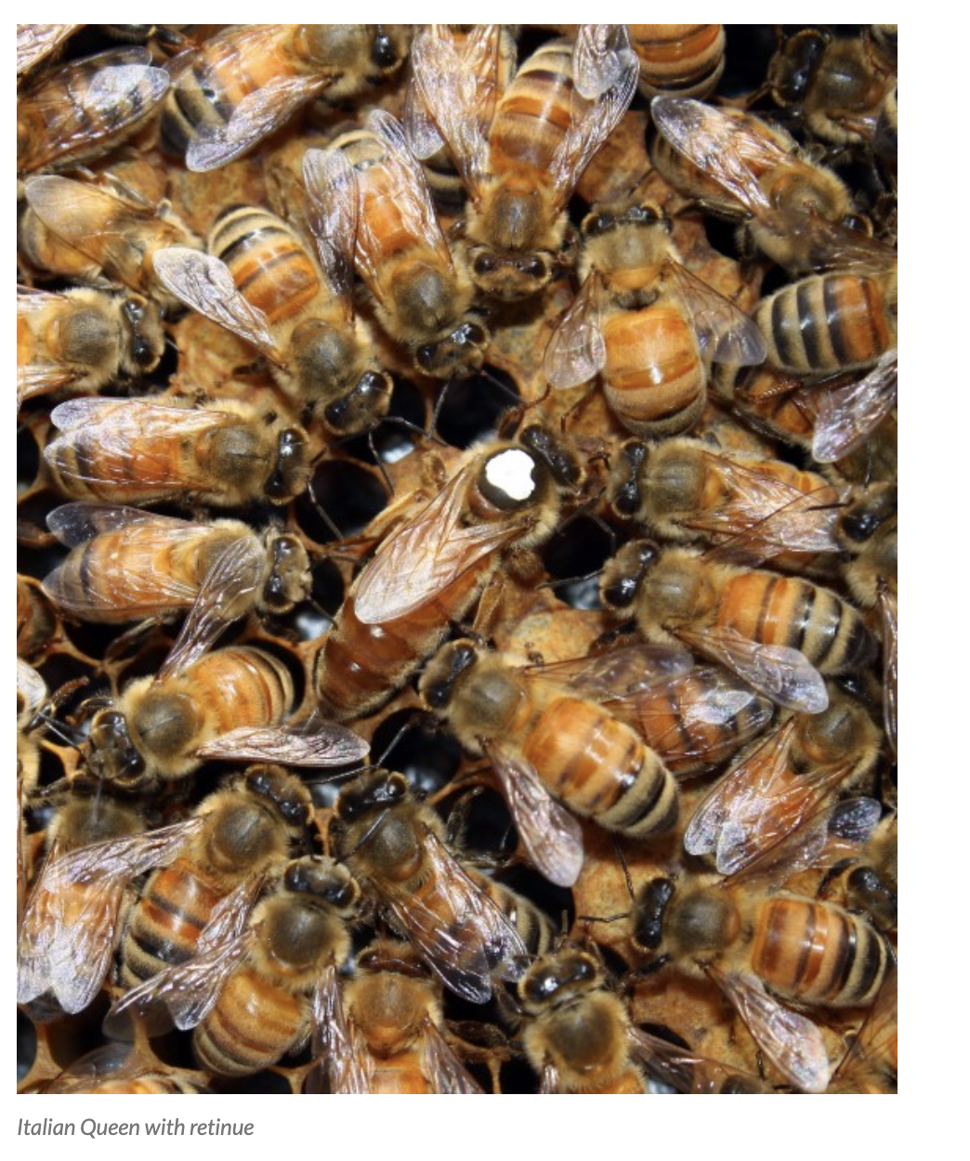
Other honeybee races in Ireland
A. m. carnica
‘Buckfast’
A. m. ligustica
http://beespoke.info
And others…… in small numbers
Some queens & packets imported per year legally but we know many brought in illegally.
Notes:
The main types of honey bees imported into Ireland are Italian and Carnolian bees although Caucasian bees are also brought in and of course Buckfast bees. The perception is that these other bees produce more honey and are not aggressive. Somehow black bees got a reputation for being aggressive. However, while these strains may produce more honey in their own regions (often where it is sunnier and with a lot more forage) evidence is just not there to support that they produce more honey in Ireland than native bees (at least without a lot of extra food and care and replacement). There are many commercial beekeepers in Ireland that use A. m. mellifera. The reputation for being aggressive is also not quite fair. Some of the aggression is actually due to hybridization- when black bees are mated with Buckfast or other imported subspecies, within a couple of generations the offspring are aggressive. This is due to being too genetically different and is one downside to hybrids. After one year of hybrid vigour aggression creeps in. Also, other strains of bees are very highly selected for docility, as part of intensive breeding programmes with associated infrastructure, and these intensive breeding programmes have been going on for a long time. The same level of attention and selective breeding has not been focused on black bees and so they retain more ancestral behaviours and some black bee colonies are naturally less docile. However, docility can be bred into black bees as evidenced by the Galtee Bee Breeders group and other queen breeders in the country,

Slide 9
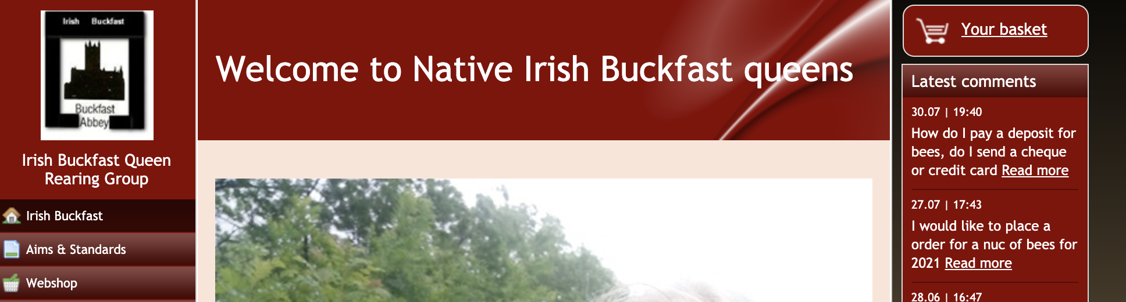
X
Buckfast : Brother Adams created after apparent demise of native UK A. m mellifera
Originally A. m. mellifera X A. m. ligustica, he later added other subspecies.
Buckfast is not a natural form of honey bee- it has been artificially bred to have particular characteristics; docile, good honey producer
Notes:
Sometimes you see ads for Irish Buckfast Queens, or native Irish Buckfast queens: well this is just not true. Buckfast bees are not native to Ireland, and they are not even a natural type of bee. They have been artificially created in the UK by mixing other types of honey bee races and then sold globally. Even Buckfast Abbey where they were first bred, have stopped breeding or using them and they now use local honey bees. Where this leaves the Buckfast strain, I don’t know, but nobody really knows what is the make up of this type of bee anymore. They are not native or Irish, however, even if queens are now being raised here. People who have Buckfast bees like them and they do well for some people but for people nearby who want to maintain native honey bees, having Buckfast introduced nearby is a big issue as they hybridise with native bees and cause subsequent generations to be aggressive. You may want to buy Buckfast bees but first please discuss with others nearby and try to make sure you don’t interfere with what’s happening locally.

Slide 10
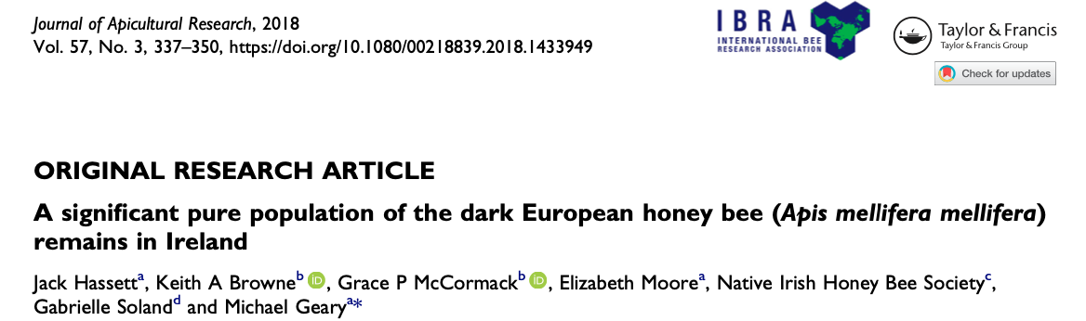
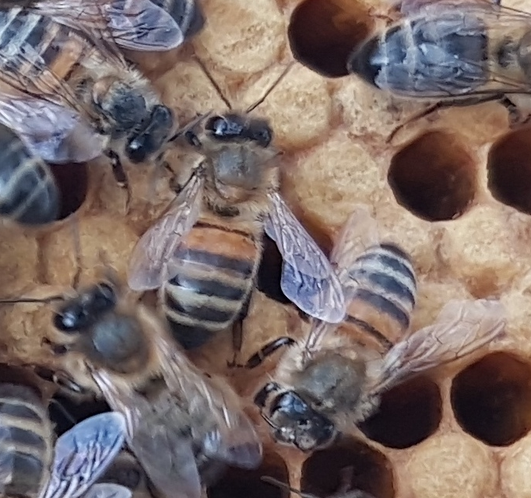
BUT almost as soon as this ‘pure’ population was discovered
A major risk from imports is being identified
The race is on to prevent what’s happened elsewhere from happening in Ireland
hybridised bee
Notes:
Before 2015 it was not clear whether A. m. mellifera was common in Ireland as there were few studies and only the Galtee bees had been shown to be indeed part of this subspecies. Once studies were done as in the slide we knew that Ireland was lucky in having retained a large population of the dark bee, probably because imports were not very high and beekeeping not very intensive. But in recent years beekeepers have started to see more evidence of hybridization. This has been born out by genetic analyses.

Slide 11
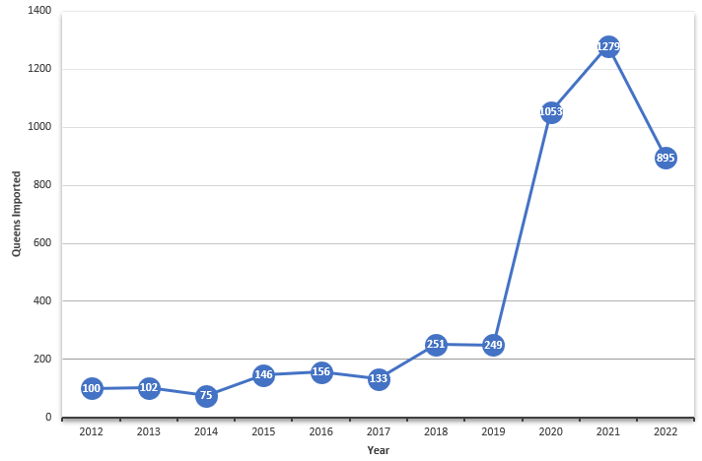
Massive rise in number of Queens Imported
In studies pre-2020 > 97% colonies tested were pure A. m. mellifera
Post 2020 higher levels of hybridization detected.
Recent study in 2024 suggest that 18-25% colonies tested showed some hybridization (most at low level)
People buying bees online is having a detrimental impact on our native population
Notes:
Imports of non-native honey bees jumped by >300% during covid. The numbers have come back down to pre-covid levels but are still higher than they were back in 2012. Continued imports and matings between imported and local bees disturbs the adaptation of native bees and may result in important traits being lost. Ireland is also lucky in having a large number of wild colonies that survive without beekeeper help, a population we could lose if their traits became impacted.

Slide 12
Conclusion & Recommendations
Sufficient evidence across multiple approaches for distinctiveness of A.m.mellifera in Ireland
Ireland is the last stronghold of A. m. mellifera in Europe
Imports of invasive subspecies and commercial strains are a threat to native population.
Please do not buy honey bees via the internet.
Please discuss with local beekeepers as to what bees are in the area and where to get good local bees.
The Native Irish Honey Bee Society has a list of people who supply native queens and nucs if you can’t get help locally.
Please be patient in getting bees, get experience from local association apiary or experienced beekeeper while you wait.

